Slide 1
EMOTIONAL INTELLIGENCE
Ms. Aqsa Fayyaz
Psychology lecturer
Science and humanities department
FAST NUCES Karachi

Slide 2
LEARNING OUTCOMES
Be able to understand different emotions and their functions
Become aware of how their emotions affect their behavior and performance.
Be able to relate more effectively to their colleagues and to others.

Slide 3
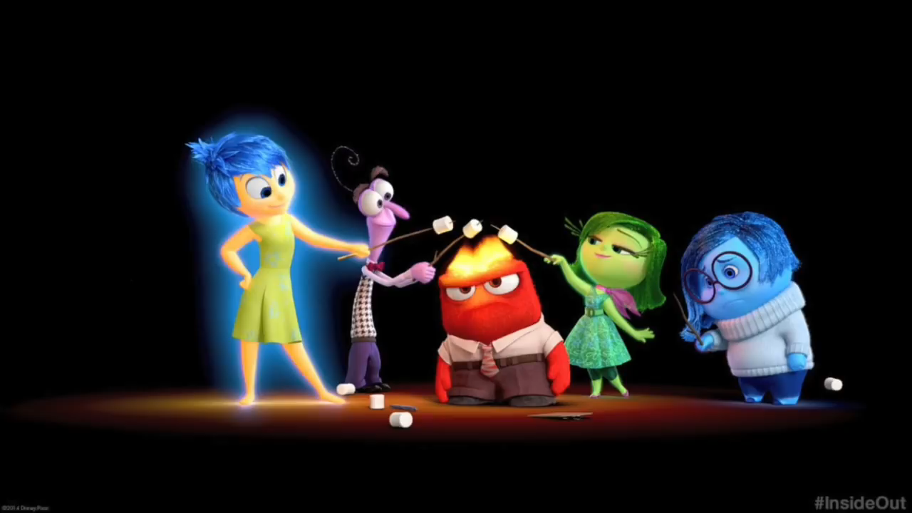
https://www.youtube.com/watch?v=dOkyKyVFnSs
Notes:
https://www.youtube.com/watch?v=dOkyKyVFnSs

Slide 4
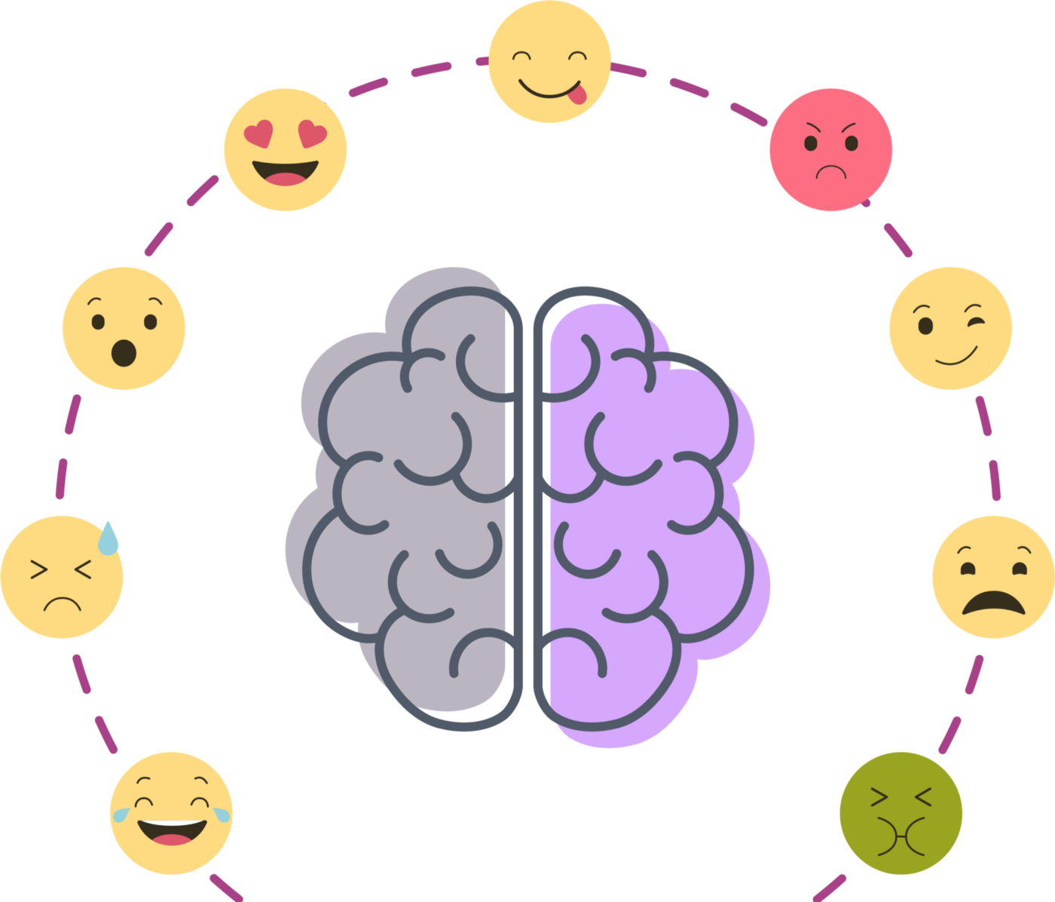
What we mean by emotions?
Subjective (personal) experience that arises unconsciously and spontaneously in response to the environment around us. It is an automated response to events that happens to us. (emotion is how the body responds)
A complex state of feeling that results in physical and psychological changes that influence thought and behavior.

Slide 5
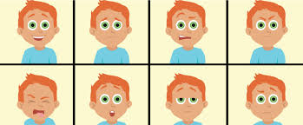
Emotions have three components:
Subjective component: How you experience the emotion (conscious experience)
For example, one person may feel anger and regret at the loss of a loved one while another may experience intense sadness.
Physiological component: How your body reacts to the emotion (rapid heartbeat etc.)
Expressive component: How you behave in response to the emotion (physical reaction)
For example: smile, a grimace, a laugh or a sigh, along with many other reactions depending on societal norms and personality.

Slide 6
Here are a few facts about emotions: Emotions come and go. Most of us feel many different emotions throughout the day. Some last just a few seconds. Others might linger to become a mood. Emotions can be mild, intense, or anywhere in between. The intensity of an emotion can depend on the situation and on the person. There are no good or bad emotions, but there are good and bad ways of expressing (or acting on) emotions. Learning how to express emotions in acceptable ways is a separate skill — managing emotions — that is built on a foundation of being able to understand emotions.

Slide 7
A study in the Journal of Abnormal Psychology found that while watching negative and positive emotional films, suppression of behavioral responses to emotion had physical effects on the participants.
The effects included elevated heart rates.
This suggests that expressing behavioral responses to stimuli, both positive and negative, is better for your overall health than holding those responses inside.
Thus, there are benefits of smiling, laughing and expressing negative emotions in a healthy way.

Slide 8
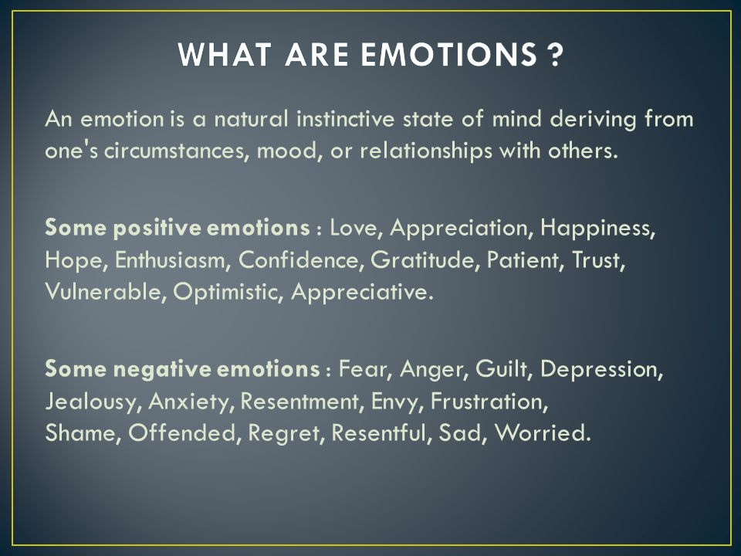

Slide 9
Why emotions are important?
It helps us build better relationships.
Emotions Help You Avoid Danger
Emotions Help Others Understand You Better
Emotions Allow You to Understand Others

Slide 10
IMAGINE A LIFE WITHOUT EMOTIONS?
Discussion
It would be impossible to develop bonds with people.
We cannot be safe since we couldn’t care less if danger meets our door.
Also, losing that unconscious function of emotions makes us lose our fight or flight reactions.
TED BUNDY CASE (ANTISOCIAL PERSONALITY)

Slide 11
Emotion Triggered by Behavioral response
Anger Being prevented from Destroy the thing
doing something you in your way, yelling, arguing, cursing and sarcasm.
you feel has deliberately
done you wrong
Fear Any threat or danger Protection often through
‘freezing’ so you are
not noticed , avoidance
Sadness Loss of something Search for help
important and comfort/Crying
Disgust Something gruesome, Reject or push away the
awful thing that is revolting
Surprise A sudden unexpected Focus on the new thing,
event wide eyes take in as
much as possible

Slide 12
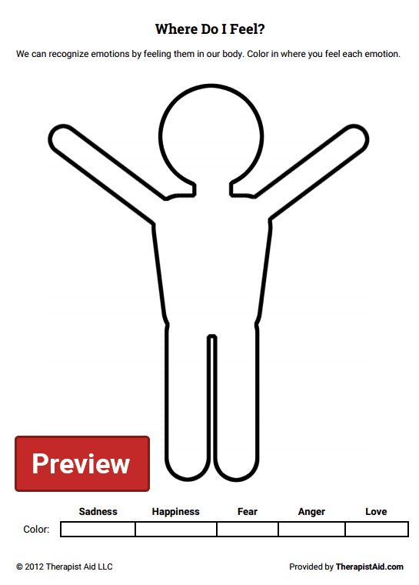
ACTIVITY

Slide 13
What is emotional intelligence?
Emotional intelligence or EI is the ability to understand and manage your own emotions, and those of the people around you. People with a high degree of emotional intelligence know what they're feeling, what their emotions mean, and how these emotions can affect other people.

Slide 14
Emotional intelligence helps us to identify, use, understand, and manage emotions in positive ways to relieve stress, communicate effectively, empathize with others, overcome challenges, and defuse conflict.
Notes:
https://careers.gazprom-mt.com/blog/how-to-develop-emotional-intelligence/
https://www.slideshare.net/rksen/presentation-on-emotional-intelligence

Slide 15
EQ >IQ Emotional Quotient is greater than Intelligence Quotient

Slide 16
FOUR COMPONENTS OF EMOTIONAL INTELLIGENCE.

Slide 17
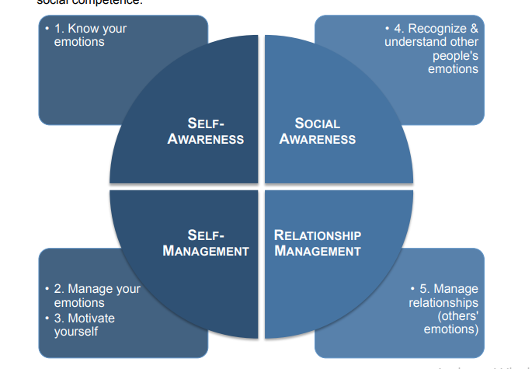

Slide 18
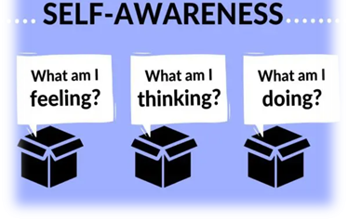

Slide 19
1. Self awareness:
Self-awareness involves being aware of different aspects of the self including traits, behaviors, and feelings
Knowing your strengths ,Weaknesses
or the ability to recognize and understand your own emotions, is a critical emotional intelligence skill.
being aware of the effect of your actions, moods, and emotions on other people
Being aware of your own feelings puts you in charge, not your emotions.

Slide 20

How to improve self-awareness:
Keep a journal
Meditate
Pay attention to your thoughts and emotions
Reflect on your experiences

Slide 21
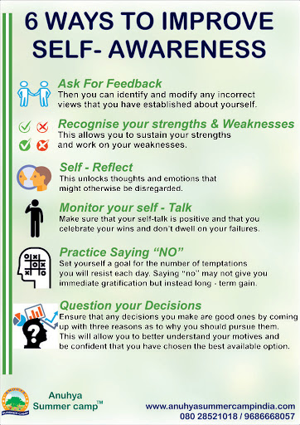

Slide 22

2. SELF MANAGEMENT:
Self management is also called self regulation
which is all about expressing your emotions appropriately

Slide 23
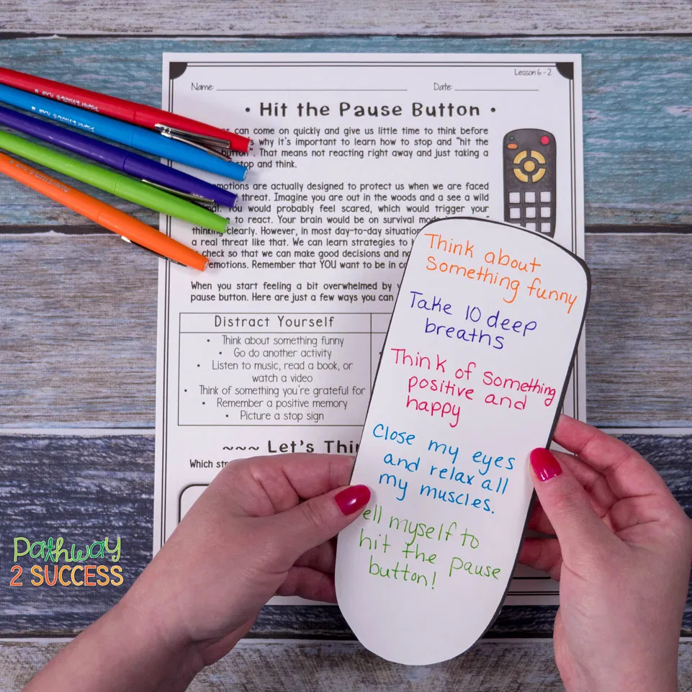
How to Improve Self-Regulation/Self management?
Recognize that you have a choice in how you respond.
Work on accepting your emotions.

Slide 24
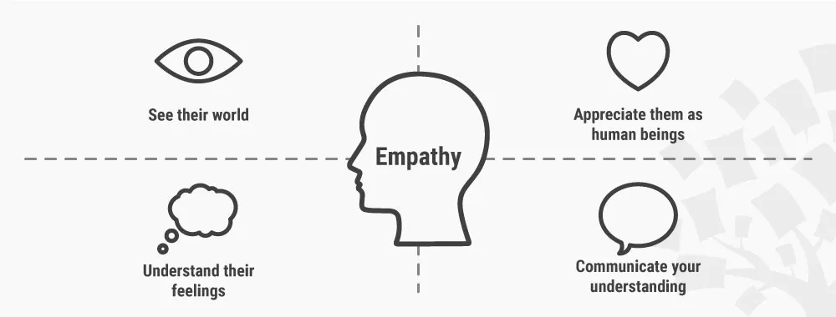
3.Social Awareness /Empathy
Empathy, or the ability to understand how others are feeling, is absolutely critical to emotional intelligence

Slide 25
How to build empathy/social awareness?
Try to imagine yourself in someone else's place.
Be willing to share your own feelings.
Engage in a cause such as a community project.
Listen to other people.

Slide 26
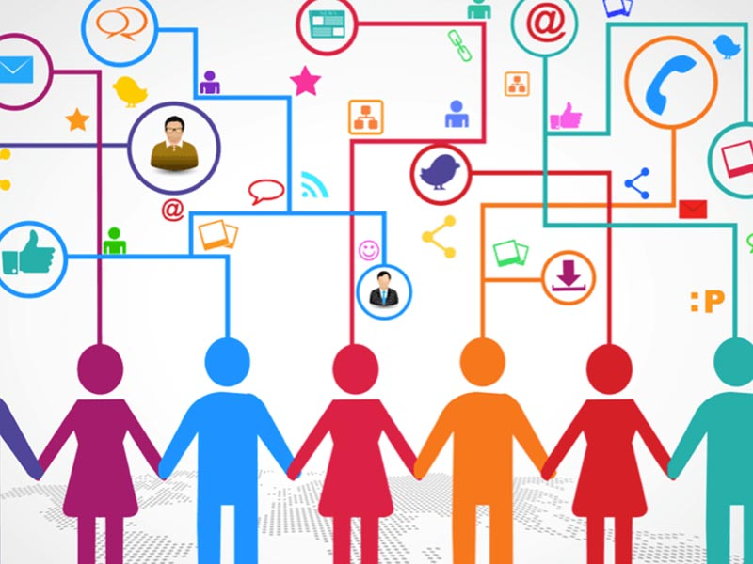
4. Social skills /Relationship Management:
Being able to interact well with others is another important aspect of emotional intelligence.

Slide 27
HOW TO IMPROVE SOCIAL SKILLS?
Practice good eye contact.
Notice other people's social skills.
Show interest in others.

Slide 28
Why Emotional Intelligence Skills Are Important
Emotional intelligence allows you to be a more effective leader.
Understanding how others are feeling allows you to communicate with them better.
Knowing more about what you are feeling allows you to be more self-aware and understand yourself more deeply.
By being more aware of your emotions, you can also improve your self-control abilities.
Managing your emotions effectively allows you to exert greater control in situations marked by stress or conflict.

Slide 29
THANKYOU!!!

